Slide 1


Design of Plant Leaf Recognition Architecture Using Azure Services and Python
By
Dr.K.V.N.Rajesh(Ph.D in Deep Learning)
Azure Trainer
CloudThat

Slide 2












My Profile
Dr.K V N Rajesh
Microsoft Certified Trainer | Subject Matter Expert
K.V.N. Rajesh is Microsoft Certified Trainer and working as a Subject Matter Expert.
I have hands-on experience on Azure services. He is specialized in delivering customized training based on customer and business needs, Corporate, Online and Classroom technical training.
I am a technology enthusiast and passionate trainer, empathic observer towards the trending technologies with demonstrated skill in Microsoft 365 Security, Azure AI and Deep Learning.
He has 16+ years of experience into Training and has trained over 10000+ participants in his career.
www.cloudthat.in

Slide 3
Outline of the Presentation
Introduction
Problem Statement
Leaf Image Dataset
Architecture
Technical Implementation
Challenges in implementing the solution
Business Benefit
Conclusion

Slide 4
Introduction
Classification of Plant Species based on leaf images is a Multiclass Classification Problem.
Machine learning techniques have already been used for Plant leaf recognition (PLR)
These techniques are based on the extraction of various hand-crafted features from plant leaf images and the usage of a machine learning classifier for classification.

Slide 5
Introduction
The Recognition Accuracy of Machine learning techniques for plant leaf image classification is dependent on the discriminability of the chosen hand-crafted features.
The usage of deep learning for plant leaf classification automates the feature extraction process
Designing the appropriate deep learning model for classification abstracts the feature extraction process.

Slide 6
Problem Statement
The current work aims at designing a deep learning model for the multiclass classification of plant leaf images.
The major focus of this work is to automatically classify and predict the plant species of the plant leaf images of Flavia leaf dataset.

Slide 7
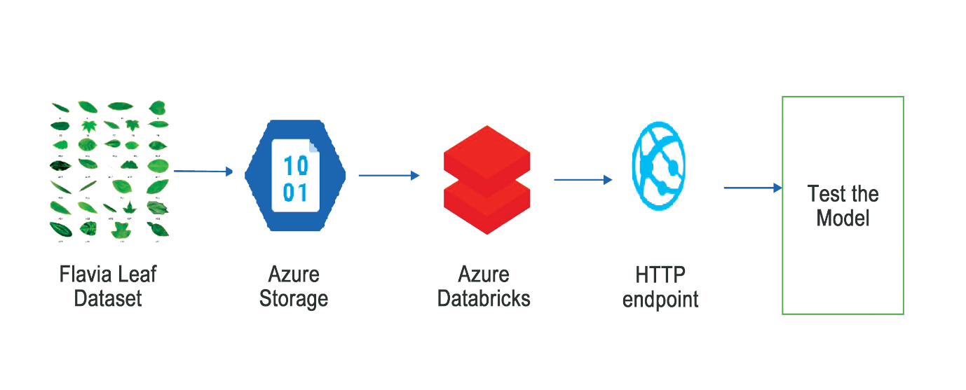
Architecture

Slide 8
Azure Services used in this work
Azure Services | Description
Azure Storage | For storage of the Flavia leaf image dataset
Azure Databricks | For training of the classification model implemented with Keras and TensorFlow
Azure ML Service | For versioning and deployment of the classification model as HTTP endpoint

Slide 9
Technical Implementation
Azure Storage is used to securely store the pictures
Azure Databricks is used to train the model using Keras and TensorFlow
Azure ML Service is used to version and deploy model as HTTP endpoint

Slide 10
Challenges in implementing the solution
The whole process of learning about deep learning models and designing the architecture in the Azure platform itself was a big challenge.

Slide 11
Business Benefit
The architecture designed in this work can be further advanced to build a mobile application for Plant leaf classification. Mobile applications are much in demand because of the wide usage of mobile phones in the current generation. An application of this nature can be very useful in identifying various species of plants across the globe.

Slide 12
Conclusion
Plants are very important for the existence of human life. The total number of identified plant species is nearing four hundred thousand as of date. With advances in Computer Vision and deep learning, the classification of plants can be done with very high accuracy based on their leaf images. Creating such a model was the motivation behind this work.

Slide 13
References
1.https://flavia.sourceforge.net/
2.https://learn.microsoft.com/en-us/azure/storage/common/storage-account-create?tabs=azure-portal
3.https://learn.microsoft.com/en-us/azure/databricks/scenarios/quickstart-create-databricks-workspace-portal?tabs=azure-portal
4.https://learn.microsoft.com/en-us/azure/architecture/reference-architectures/ai/training-deep-learning

